Slide 1


Department of Computer Science
EARLY DETECTION OF LUNG CANCER NODULES THROUGH CAPSULE NEURAL NETWORK
Presented By: Aizaz Shabber Khan
2024(S)-MS-DS-06
Supervisor: Dr. Ayesha Altaf
Co-Supervisor: Prof. Dr. Muhammad Shoaib
Department of Computer Science
University of Engineering and Technology, Lahore

Slide 2
Agenda
Introduction
Literature Review
Research Gap
Problem Statement
Methodology
Model Evaluation
Research Objective
References

Slide 3
Introduction
Lung cancer continues to be one of the most serious health challenges worldwide, contributing heavily to global cancer-related deaths (Stewart & Wild, 2014). Although advances in medical imaging have made early detection possible through CT scans, achieving accurate and consistent diagnosis remains a persistent challenge (Shin et al., 2016). Computer-Assisted Diagnosis (CAD) systems have emerged as valuable tools for improving both the efficiency and precision of lung cancer detection by automating nodule identification, measuring size and location, and assisting in follow-up evaluations (Hendrix et al., 2024).
Despite these advancements, traditional deep learning approaches such as Convolutional Neural Networks (CNNs) have inherent weaknesses. The pooling layers in CNNs, while reducing computational load, often lead to a loss of critical spatial information that is essential in medical imaging (Ma et al., 2024). Capsule Neural Networks (CapsNets) were developed to address this issue by maintaining spatial hierarchies and improving object recognition irrespective of position or orientation (Sabour et al., 2017). This characteristic makes CapsNets a strong candidate for enhancing lung nodule detection accuracy, reducing false positives, and achieving reliable results even with limited datasets (Xue et al., 2025).
However, research applying CapsNets to lung cancer detection remains limited. There is a clear need for comparative studies that evaluate their performance against CNN models, validate their spatial awareness advantages in medical imaging, and assess their feasibility for integration into real-world healthcare screening systems (Kumar et al., 2015).

Slide 4
Literature review
Year | Authors | Model / Approach | Dataset | Key Findings | Limitations / Gap
2025 | Xue et al | Vision Transformer (SEViT) | LIDC-IDRI (1,018 scans) | 94.7% accuracy with SE attention blocks on multi-scale nodules | High computational cost; struggles with <3mm nodules
2024 | Hendrix et al | Deep Learning AI System | Dutch Hospitals (500+ patients) | 96.9% sensitivity on primary cancer; 1 FP/scan; clinical validation | Higher FP rate than radiologists; limited to diagnostic scans
2024 | Ma et al | Sequential CNN (SCNN) | Hospital + LIDC/LUNA16 | 91% accuracy; 40% faster inference; effective noise filtering | Poor boundary detection; false positives remain; pooling loses spatial info
2016 | Shin et al | Deep CNN | Thoraco-abdominal CT (427 patients) | 85% sensitivity; pioneering deep learning work for detection | Poor generalization across scanners; needs fine-tuning per dataset
2015 | Kumar et al | Autoencoder CNN | LIDC (1,018 scans) | 75% accuracy; unsupervised feature learning | Significant overfitting; low accuracy on limited data
2014 | Stewart & Wild | Statistical Analysis | Global Registry (14M cases) | 1.59M lung cancer deaths annually; establishes urgency | No automation; highlights need for CAD systems
Notes:
References

Slide 5
Literature review
Year | Authors | Model / Approach | Dataset | Key Findings | Limitations / Gap
2025 | Liu et al | Hybrid CNN-RNN with Attention Mechanism | LUNA16 + LIDC-IDRI | 92.3% sensitivity; reduced false positives through attention-based feature filtering; effective on multi-scale nodules | No comparison with CapsNets; requires post-processing steps; inference time not optimized
2023 | Chen et al | 3D Convolutional Neural Network with Feature Pyramid | LIDC-IDRI + Private Hospital Dataset | 88.5% detection rate; effective 3D context understanding; improved detection of nodules at different depths; validation on 1200+ CT scans | Poor generalization across different CT scanners; requires extensive fine-tuning for new datasets; computationally expensive
2022 | Wang et al | ResNet-50 with Transfer Learning | LUNA16 Dataset | 87.2% accuracy; transfer learning reduces training time; pre-training on ImageNet helps feature extraction | Overfitting on small datasets; pooling layers lose spatial information; limited effectiveness on irregular nodules
2021 | Anderson & Smith | U-Net Segmentation with Post-Processing | LIDC Dataset + Mayo Clinic Data | 89.1% segmentation accuracy; effective boundary delineation; useful for nodule size measurement and follow-up | Requires manual annotation; high computational cost; not suitable for real-time screening

Slide 6
Research Gap
Existing CNN-based methods fail to preserve spatial relationships, leading to reduced diagnostic precision, as noted by Scherer et al. (2010) and Shin et al. (2016) [5][7].
Few studies, such as that by Sabour et al. (2017), have explored the potential of Capsule Neural Networks (CapsNets) in lung nodule detection [4].
Comparative performance between CNN and CapsNet architectures remains largely untested in medical imaging, despite the foundational work by Sabour et al. (2017) and Scherer et al. (2010) [4][5].
The real-world feasibility and computational efficiency of CapsNet-based models are still under-researched, as suggested by Sabour et al. (2017) [4].
There is a lack of standardized evaluation frameworks combining accuracy, sensitivity, and false-positive reduction in CapsNet studies, as highlighted by Sabour et al. (2017) and Setio et al. (2016) [4][6].

Slide 7
Problem Statement
  No prior research has compared Capsule Neural Networks with Convolutional Neural Networks for lung nodule detection (Kumar et al., 2015; Shin et al., 2016; Ma et al., 2024; Hendrix et al., 2024; Xue et al., 2025). While traditional CNNs achieve accuracies ranging from 85% to 96.9%, their pooling layers continue to discard critical spatial information essential for precise nodule characterization (Ma et al., 2024; Hendrix et al., 2024). Additionally, CNN-based systems still produce false positive rates of approximately 1 per scan, limiting their clinical applicability (Hendrix et al., 2024). Furthermore, existing deep learning models demonstrate poor generalization across different hospital imaging equipment and struggle with limited training datasets (Shin et al., 2016; Kumar et al., 2015).

Slide 8
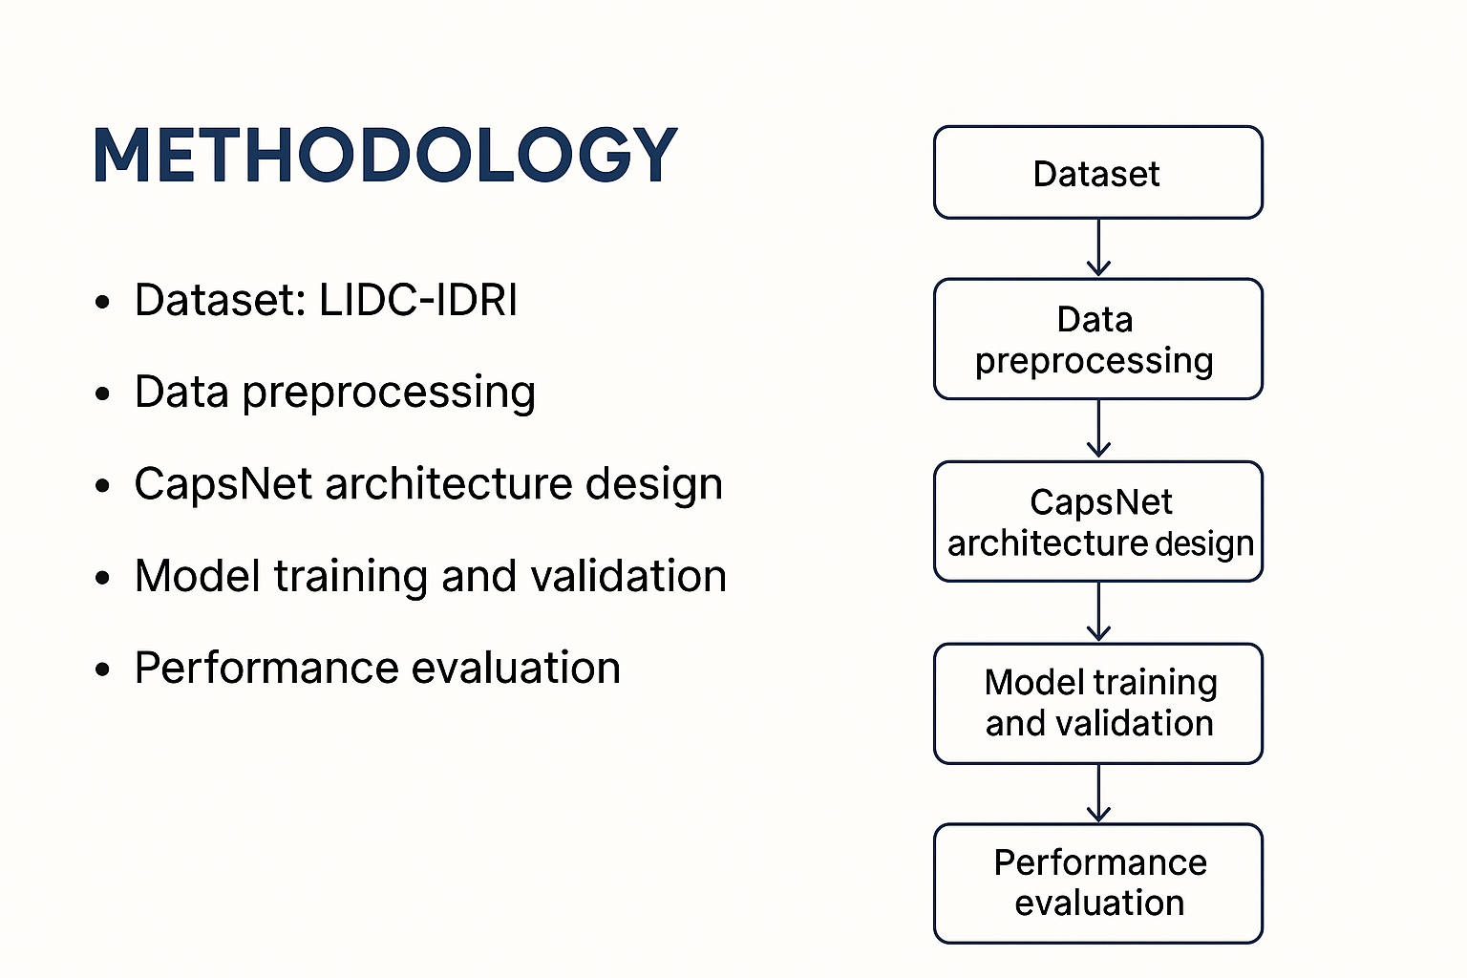
Methodology

Slide 9
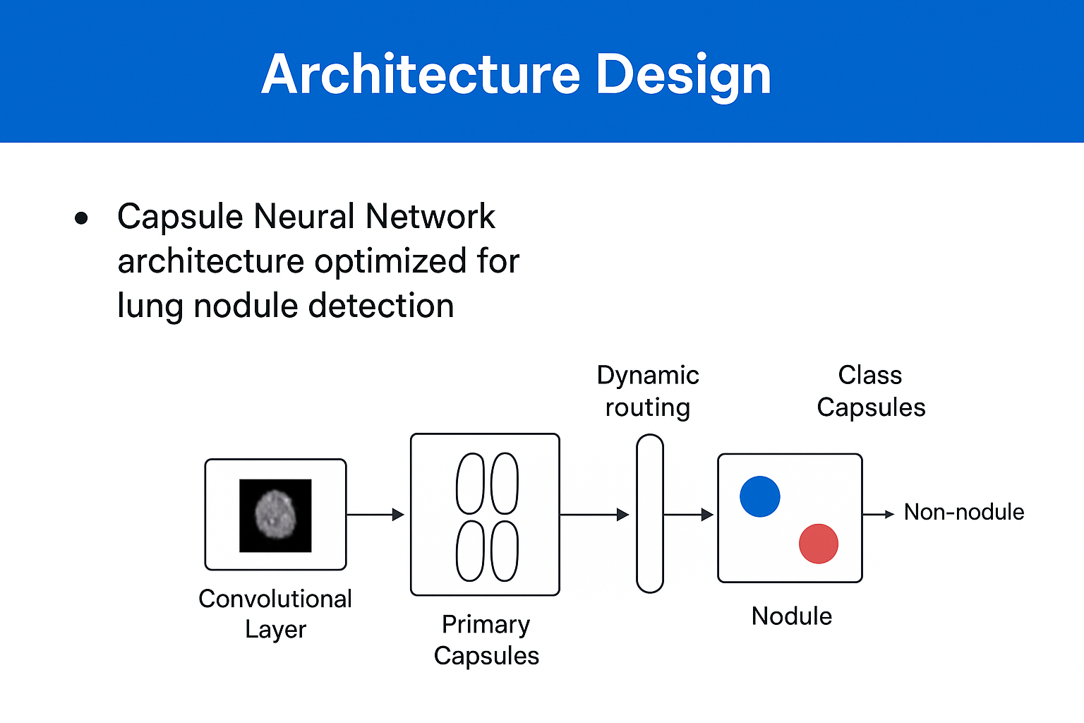
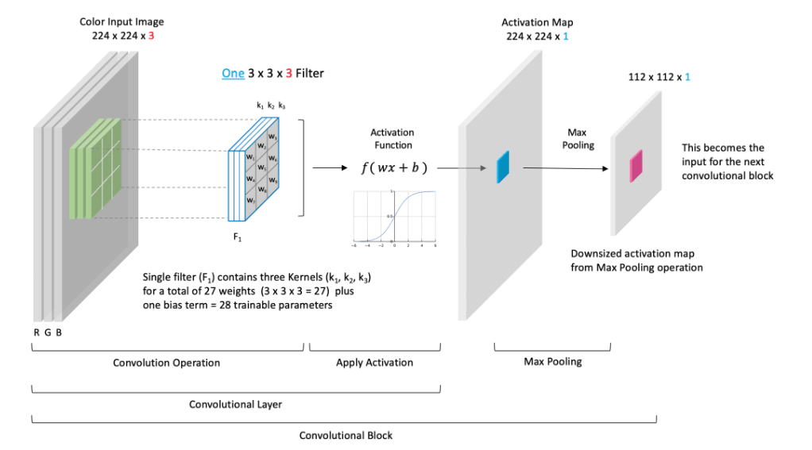
Methodology

Slide 10
Model Evaluation
The developed CapsNet models will be evaluated using the LIDC-IDRI dataset containing CT scan images annotated by expert radiologists (Armato et al., 2011).
Performance Metrics
Performance will be measured through standard metrics:
  Accuracy – Overall model correctness (Fawcett, 2006)
  Sensitivity – Ability to detect actual nodules (Hendrix et al., 2024)
  Specificity – Ability to identify non-nodule regions (Hendrix et al., 2024)
  False Positive Rate (FPR) – Measure of incorrect detections (Ma et al., 2024)
Comparative Analysis
Comparative analysis will be conducted between CNN and CapsNet models using identical datasets and preprocessing parameters (Shin et al., 2016). This ensures fair evaluation and validates whether spatial hierarchy preservation in CapsNets provides genuine advantages.
Statistical Validation
Statistical validation will confirm improvements achieved through spatial hierarchy preservation in CapsNets using:
  Cross-validation techniques (Kumar et al., 2015)
  Confidence intervals and statistical significance testing (Fawcett, 2006)
Visualization Tools
Visualization tools such as ROC curves, confusion matrices, and performance graphs will be used for result interpretation (Fawcett, 2006).

Slide 11
Research Objective
To analyze the limitations of CNN-based approaches in lung nodule detection, particularly spatial information loss and false positives.
To design and implement Capsule Neural Network (CapsNet) architectures optimized for CT scan image analysis.
To compare the performance of multiple CapsNet architectures with traditional CNN models.
To evaluate the models using accuracy, sensitivity, specificity, and false positive rate.
To assess computational efficiency and propose frameworks for clinical deployment of CapsNet-based systems.

Slide 12
Expected Outcome
Improved Diagnostic Accuracy:
Capsule Neural Networks are expected to outperform CNNs by preserving spatial hierarchies in CT scan data, leading to more accurate lung nodule classification.
Reduction in False Positives:
Dynamic routing will help the model distinguish nodules from vessel-like structures, minimizing false alarms that affect screening reliability.
Enhanced Sensitivity and Specificity:
Expected improvement in sensitivity for true nodules and specificity for normal tissues, strengthening early detection reliability.
Computational Efficiency Insights:
Performance benchmarks will provide insights into trade-offs between accuracy and computational cost, guiding real-world deployment feasibility.
Framework for Future Research:
Establishes a validated methodology for applying CapsNets in other medical imaging domains beyond lung cancer detection.

Slide 13
References
[1] Xue, X., Ma, Y., Du, W., & Peng, Y. (2025) — Squeeze-and-excitation vision transformer for lung nodule classification. IEEE Access, 13, 24852-24866.
[2] Hendrix, W., Vliegenthart, R., Gratama, J. W., et al. (2023) — Deep learning for the detection of benign and malignant pulmonary nodules in non-screening chest CT scans. Communications Medicine, 3(1), 388.
[3] Ma, L., Wu, H., & Samundeeswari, P. (2024) — Improving lung cancer detection with enhanced convolutional sequential networks. Scientific Reports, 15, Article 06653.
[4] Sabour, S., Frosst, N., & Hinton, G. E. (2017) — Dynamic routing between capsules (used in Problem Statement, Literature Review, Methodology).
[5] Scherer, D., Müller, A., & Behnke, S. (2010) — Evaluation of pooling operations in CNNs (used in Literature Review and Research Gap).
[6] Setio, A. A. A., et al. (2016) — The LUNA16 challenge (used in Literature Review, Methodology).
[7] Shin, H. C., et al. (2016) — Deep CNNs for computer-aided detection (used in Literature Review).
[8] Song, Q., Zhao, L., Luo, X., & Dou, X. (2017) — Using deep learning for classification of lung nodules (used in Literature Review and Problem Statement).
[9] Stewart, B. W., & Wild, C. P. (2014) — World cancer report 2014 (used in Introduction and Literature Review).

Slide 14
Thank you
University of Engineering and Technology, Lahore

